Slide 1

DeepFake Audio Detection
Beyond the waveform

Slide 2

Team Members:
Walaa Hassan Abdelraouf
Walaa Abdelkader Elnokrashy
Avronia Isaac Bekhit
Hagar Osama Mohammed
Yasmin Maher Ibrahim
Farah Mohamed Ahmed
Maryam Wael Muhammed
Supervised By:
Prof. Dr/ Mervat Mikhail

Slide 3










Outlines
Introduction
Software Development
Survey work
UML Diagrams
Related Work
Frontend Development
Tools & Frameworks
Backend & Database
Future Work

Slide 4

Introduction
Chapter 1

Slide 5

Unmasking the Voice: Deepfake Audio Crimes and Their Implications
Imagine receiving a call from your CEO asking for an urgent wire transfer. The voice is unmistakable—familiar, authoritative, and urgent. You comply… only to discover that the voice was fake, generated by AI. Welcome to the chilling world of deepfake audio crimes.

Slide 6
Case Studies – Deepfake Audio Crimes
UK Energy Company Fraud (2019):
$243,000 stolen using AI-generated CEO voice; scam exposed after errors in a second request.
Peruvian Extortion Scams:
Cloned voices from social media faked kidnappings, tricking victims with emotional pleas.
Chilean Mining Fraud (2021):
$1.5M lost to a fake CEO voice demanding urgent transfers.
Argentinian Scams (2020):
$600,000 stolen in 10 days using deepfake voices combined with social engineering tactics.

Slide 7
The Growing Risks of AI Misuse
Impact: Deepfake audio crimes lead to financial losses, emotional manipulation, and erosion of trust.
Urgency: Innovative detection solutions are essential as criminals increasingly exploit AI.

Slide 8
Our Application
Chapter 1

Slide 9
Introducing Our Application
Detects deepfake audio in real time by analyzing subtle inconsistencies in audio patterns.
Provides reliable protection for individuals and organizations against voice manipulation.

Slide 10
Survey Work
Chapter 2

Slide 11
Survey Process Flow
Collected papers: 35 papers
Assigned papers: 5 per member
Filtered papers: 7 papers
Analyzed datasets: 7
Final selected papers: 3

Slide 12
Surveying Papers
The paper explores detecting fake speech from advanced voice technologies.
The paper uses MFCC features to improve deepfake audio detection with classification models.
The paper focuses on detecting replay attacks using real voice recordings to bypass authentication.

Slide 13




Champion Model and Dataset
Normal Dataset
GBoost Model

Slide 14
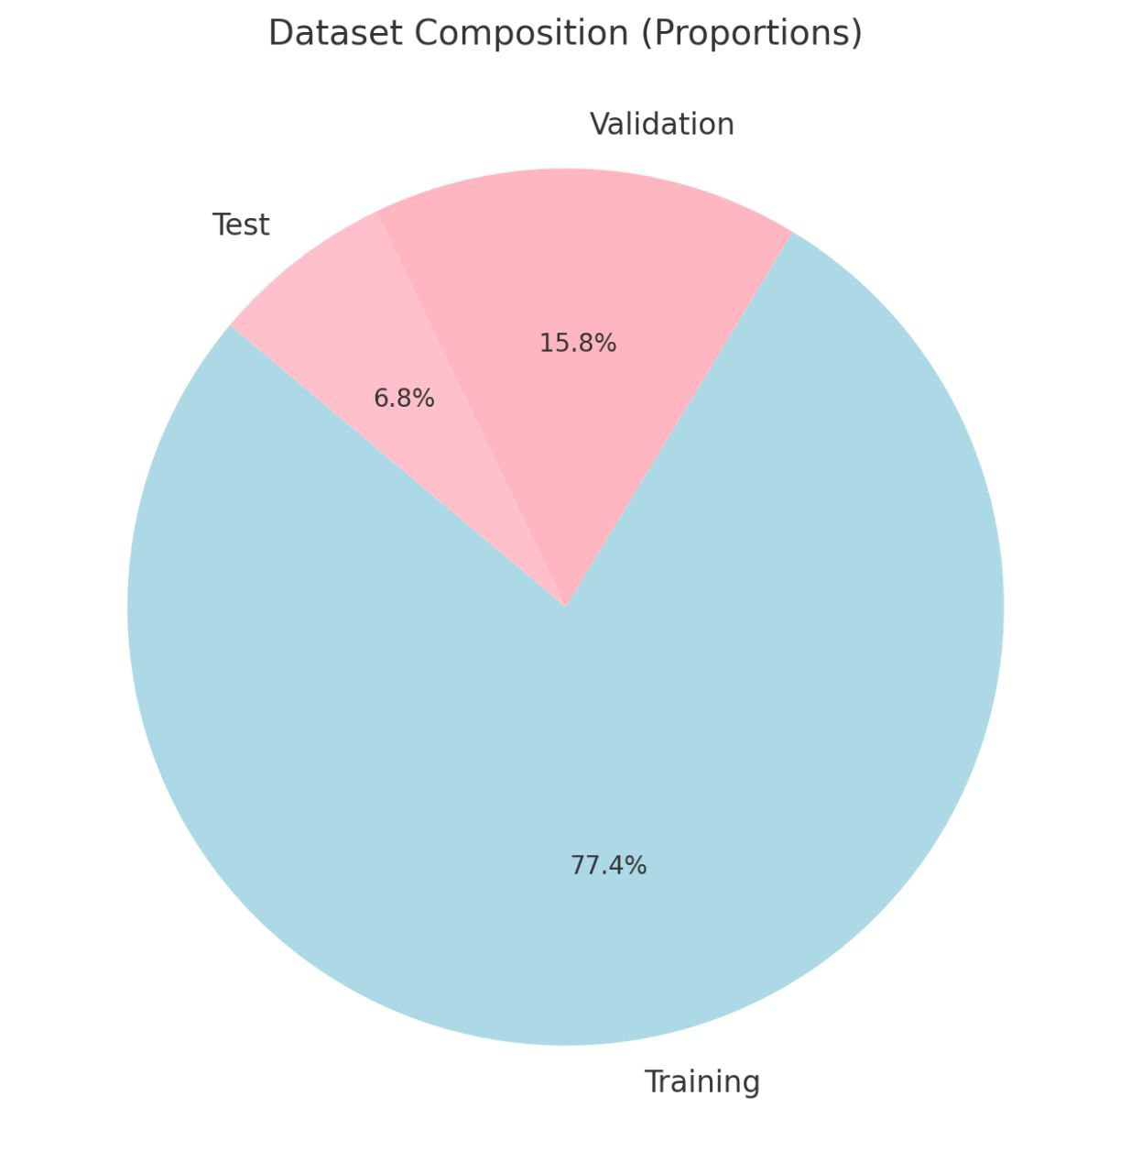
Dataset Used
The study employs the for-norm subset from Fake-or-Real dataset.
Dataset Composition:
    Training Set: 53,000 samples.
    Validation Set: 10,800 samples.
    Test Set: 4634 samples.

Slide 15
Preprocessing Techniques
Duplicate Removal
0-Bit File Removal
Normalization
Zero Padding
Feature Engineering
Preprocessing

Slide 16
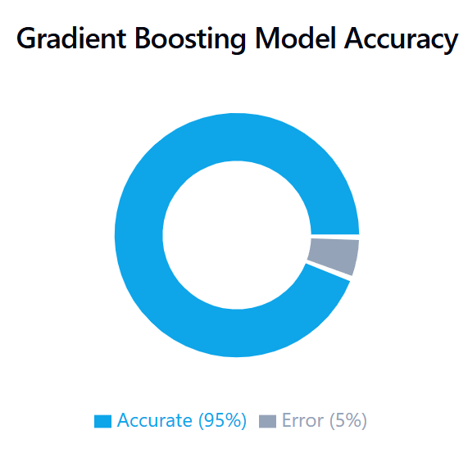
Gradient Boosting:
Best performance on for-norm dataset with accuracy (95%).

Slide 17
Related work
Chapter 2

Slide 18
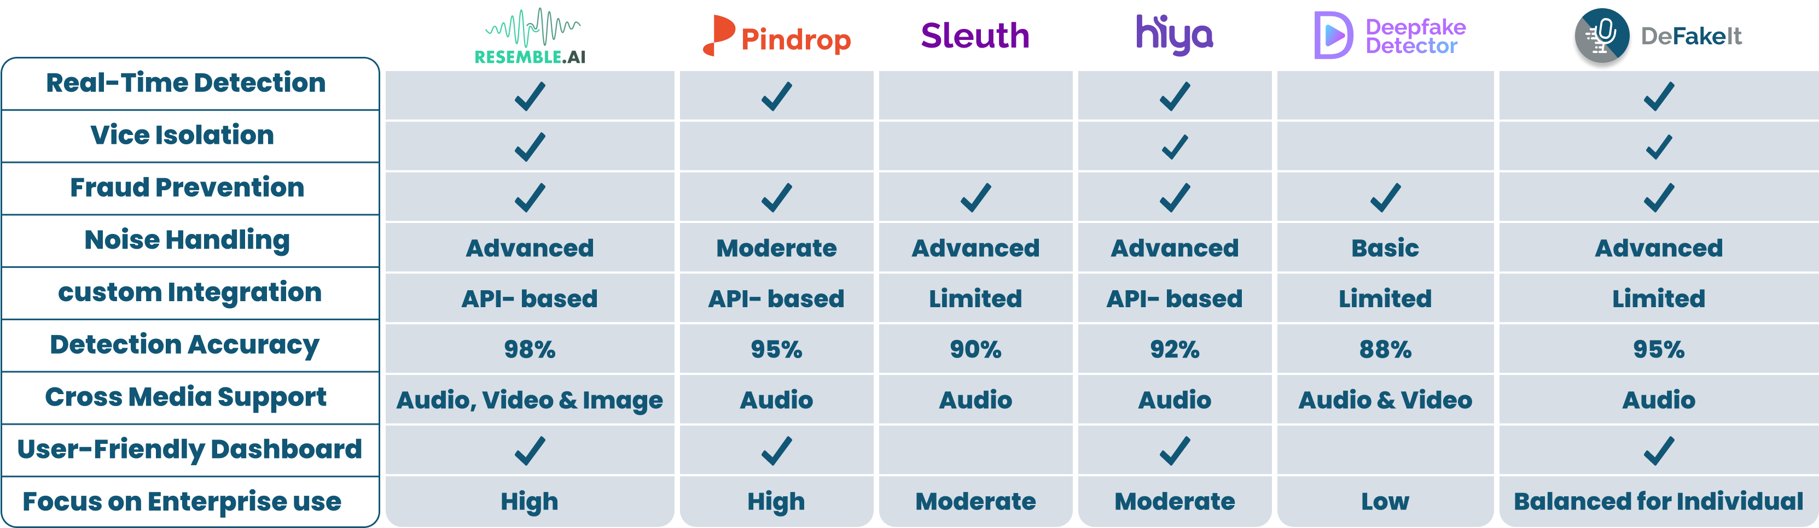
Competitor Feature Comparison

Slide 19
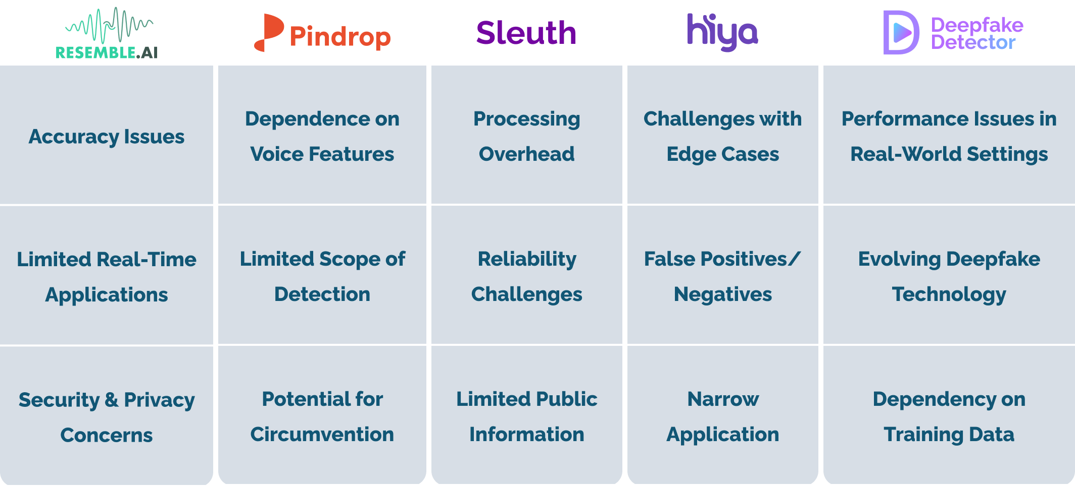
Competitors' Weaknesses

Slide 20
What Makes Our App Unique?
01
High Accuracy (95%)

Slide 21
What Makes Our App Unique?
01
01
02
Real-Time Detection with High Accuracy
Fraud Prevention
High Accuracy (95%)

Slide 22
What Makes Our App Unique?
01
02
03
Real-Time Detection with High Accuracy
Fraud Prevention
User-Friendly Design
High Accuracy (95%)

Slide 23
What Makes Our App Unique?
01
02
03
04
Real-Time Detection with High Accuracy
Fraud Prevention
User-Friendly Design
User-Focused Design
High Accuracy (95%)

Slide 24
What Makes Our App Unique?
01
02
03
04
05
Real-Time Detection with High Accuracy
Fraud Prevention
User-Friendly Design
User-Focused Design
High Accuracy (95%)
Noise Handling &
Voice Isolation

Slide 25
Tools & Frameworks
Chapter 2

Slide 26

Machine Learning Tools Comparison
Librosa
preferred choice for academic and industrial projects.
PyDub
Simple to use, making it a good choice for basic preprocessing tasks.
Wave
Efficient for simple operations like reading and writing .wav files.
OpenSMILE
An industry-standard tool widely used for speech and audio feature extraction, including emotion and spoof detection.

Slide 27
Frameworks Comparison
Scikit-Learn
Ideal for traditional machine learning models like SVM, Decision Trees, and Random Forest.
TensorFlow
Broad support for production and mobile deployment.
Pytorch
Highly flexible and preferred for research and experimentation.

Slide 28
Software Development
Chapter 3

Slide 29
Why Agile?
Flexibility and Adaptability
Iterative development
Regular sprint reviews
Integration of ML advancements
Delivery of a high-quality solution

Slide 30
Business Requirements
Purpose:
Detect and analyze audio authenticity.
Goals:
Enhance security and reliability.
Combat misinformation and fraud.
Ensure trustworthiness of audio content.

Slide 31
System Features - Functional Requirements
1. User Account and Authentication
Register using email or social media.
Password reset functionality.
2. Audio File Input
Supports formats: MP3, WAV, FLAC.
Record audio directly or upload from storage.
Validates file size and type.
3. Audio Analysis and Results
Detects markers of synthetic or manipulated audio.
Results:
Categorized as “Genuine” or “Fake”.
Includes confidence score and explanatory notes.

Slide 32
System Features - Functional Requirements (Con.)
4. User Interaction and Feedback
Save and share results.
5. Multilingual Support
Analyzes audio in English, Arabic, and Spanish.
6. User History and Data
Maintains history of all audio checks.
Provide feedback to improve the system.
Accessible via user accounts.

Slide 33
System Features - Non-Functional Requirements
Performance
Processes audio in 3-7 seconds.
Supports files up to 30 MB.
Security
Ensures privacy by not storing uploaded files.
Implements strong authentication mechanisms.
Usability
easy-to-use interface.
Responsive design for mobile and tablets

Slide 34
System Features - Non-Functional Requirements (Con.)
Reliability
High accuracy in detecting fake audio.
Compatibility
Android (min. version 8.0) and iOS (min. version 13.0).
Scalability
Supports up to 1,000 simultaneous users.
99.9% uptime guarantee.

Slide 35
UML Diagrams
Chapter 3

Slide 36
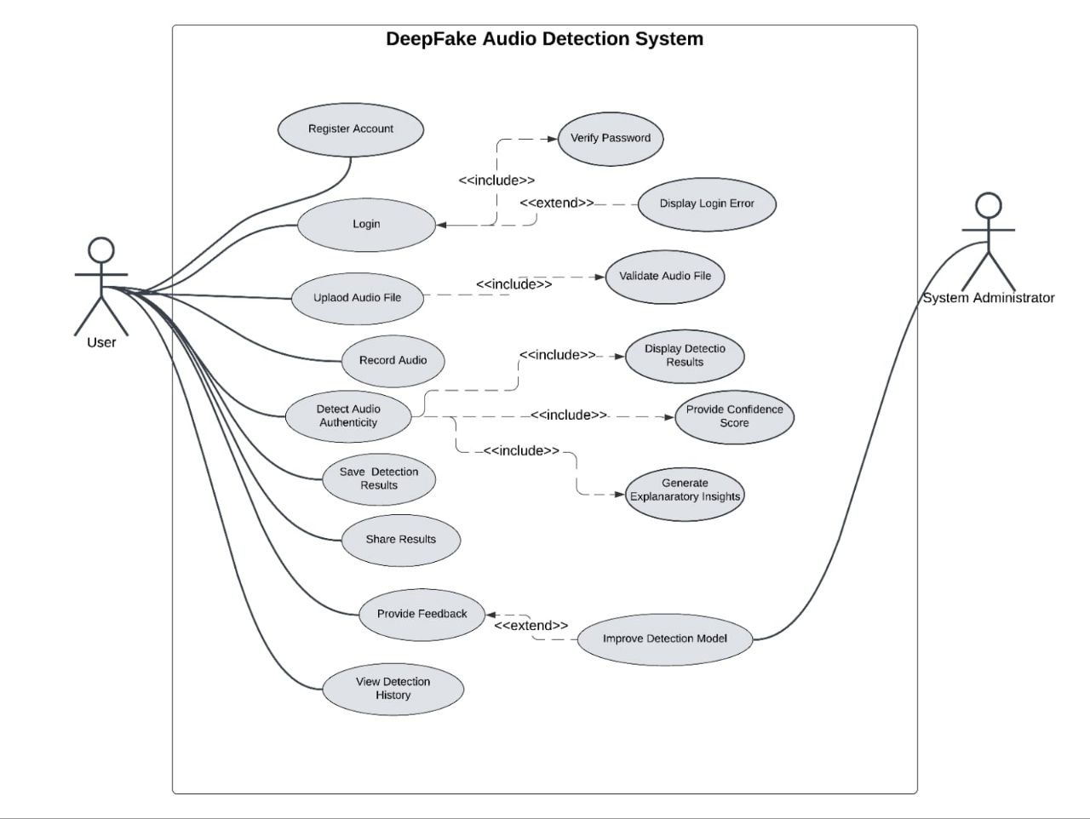
Use Case Diagram

Slide 37
Frontend Development
Chapter 4

Slide 38
Why Flutter?
Cross-Platform Development.
Native-Like Performance.
Rapid Development (Hot Reload).
Rich UI Capabilities.
Strong Developer Tools.

Slide 39
Mobile Frameworks Comparison:
Properties | Flutter | React Native | Native | Swift (iOS)
Performance | ✓ |  | ✓ | ✓
Native-like Performance | ✓ |  | ✓ | ✓
Cost and time-to-market | ✓ | ✓
Visual consistency between platforms | ✓
Hot reload | ✓ | ✓
Cross-Platform | ✓ | ✓

Slide 40
Framework Limitations:
Flutter:
Larger app size
Limited platform-specific features
Swift:
iOS only
Steep learning curve
React Native:
Performance limitations
Complex UI customization
Kotlin (Android):
Android only
Higher development cost

Slide 41
Backend Development
Chapter 4

Slide 42
Why Use a Backend Framework?
Efficient API Management
Integration with AI Models
Database Abstraction
Security
Scalability
Caching

Slide 43
Backend Frameworks Comparison:
Property | FastAPI | Django | Flask | Spring Boot | Express.js
Performance | High | Moderate | Moderate | Moderate | High
Non-Blocking | Excellent | Limited | Limited | Limited | Excellent
Security | Excellent | Excellent | Moderate | Enterprise-grade | Moderate
API Handling | Excellent | Excellent | Moderate | Excellent | Excellent
Integration with AI/ML | Excellent | Excellent | Moderate | Good | Good
Real-time Features | Excellent | Moderate | Limited | Limited | Excellent
Scalability | High | Moderate | Moderate | High | High

Slide 44
Why FastAPI?
High Performance
Real-Time Support
AI Integration
Interactive Docs
Scalability
Limitations: Requires external libraries for ORM and advanced security.

Slide 45
Why Django?
Feature-Rich
Security
Rapid Development
Scalability
Limitations: Heavy for real-time tasks.

Slide 46
Combined Usage:
FastAPI:
Handles high-performance API requests.
Supports real-time features and AI/ML integration.
Django:
Manages user data, historical records, and admin interfaces.
Provides a secure and robust backend infrastructure.

Slide 47
Database
Chapter 4

Slide 48
The Role of Databases in Detection
Why Are Databases Crucial ?
Data Management: Efficiently handles large datasets, including audio features and metadata.
Structure: Provides integrity, scalability, and performance for real-time detection workflows.

Slide 49
PostgreSQL Advantages Over MySQL:
Complex Queries:
Advanced support for JSON, CTEs, and window functions.
Indexing:
Optimized methods like GIN and BRIN for fast lookups.
Extensibility:
Allows custom functions and operators for specialized needs.
Reliability:
ACID compliance ensures data accuracy and transaction safety

Slide 50
PostgreSQL Features for Audio Detection
Key Features of PostgreSQL:
Structured Data Storage: Handles user records and prediction results effectively.
Advanced Indexing: Supports large datasets with indexing options like B-Tree, GIN, and BRIN.
Flexibility: Works seamlessly with JSON/JSONB for semi-structured data like audio metadata.
Security: Offers role-based access, SSL, and encryption for protecting sensitive data.

Slide 51
PostgreSQL in Practice – Real-Time Audio Detection
Handling Big Data: Optimized for high-performance operations in detection systems.
Full-Text Search: Efficiently processes metadata and transcripts for real-time analysis.
Replication and Reliability: Built-in failover mechanisms ensure consistent availability.

Slide 52
Future Work

Slide 53

In future developments, the mobile application will incorporate advanced algorithms to detect and identify fake audio content during phone calls, enhancing its capability to ensure the authenticity of communications.

Slide 54
Prototype

Slide 55


